Slide 1


Slide 2
Project Highlights
Project Name : Supermarket Management system
Team Size : 4
Team Members Details
Arvindan P – 99004440
Chinmayi B C – 99004441
G Sri Nishanth – 99004442
Shravya K N - 99004443

Slide 3
Supermarket management system
The objective of the “Supermarket Management System “is to produce the monitoring the supermarket.
The project Supermarket Management System is developed with the objective of making the system reliable, easier, fast, and more informative
The admin can create a product, display all the products, display all the price list, modify any product and can also delete any product.
The user can place the order of their interest with all the available products in the market.
The goal of this phase is to develop the internal logic of each of the modules identified during the system design.

Slide 4
FEATURES
Easy to use
The user is allowed to create a product ,Show a particular product Display all the products ,Display all the price list ,Modify any product and Delete any product.
End-to-end encrypted
Accessible from anywhere
Reduces time taken

Slide 5
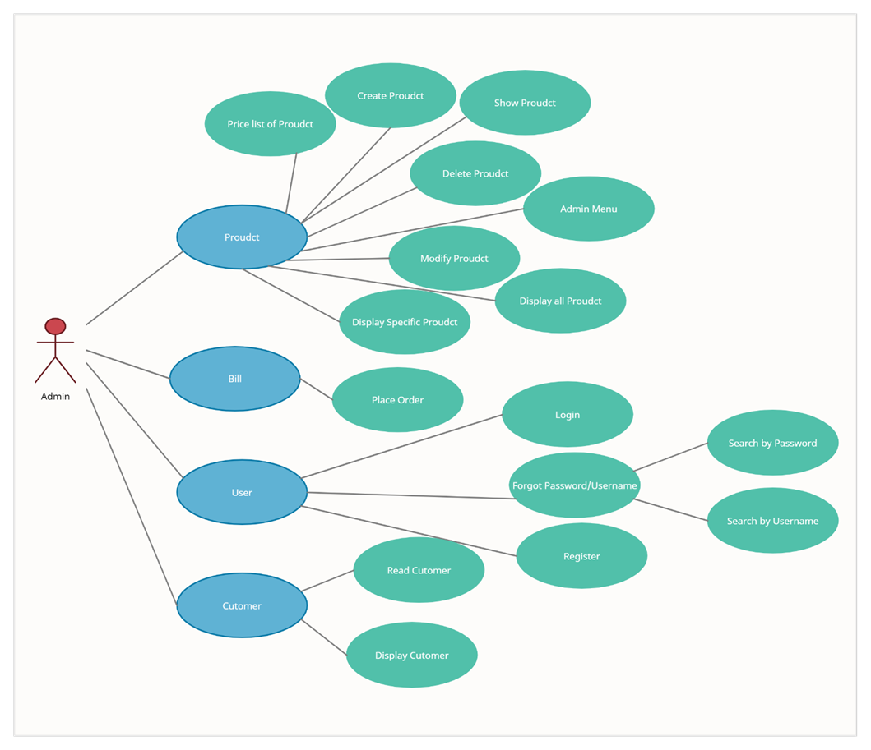
High level use case behavioral diagram

Slide 6
High level Test Plan
Test ID | Description | Exp I/P | Exp O/P | Status | Type of Test
H_01 | Maintaining the User Login credentials in .txt file | username and password | .txt file has all user data | Passed | Requirement Based
H_02 | Maintaining product details in .dat file | product class input | .dat has all product details | Passed | Requirement Based
H_03 | Printing the bill | User and Product class | generation of bill | Passed | Requirement Based
H_04 | Display of menu for user | Inputting the choice in product class | Display of menu | Passed | Requirement Based
H_05 | Fetching the product details based on product id | product ID | Display of product details | Passed | Requirement Based

Slide 7
Low level Test plan
Test ID | Description | Exp I/P | Exp O/P | Status | Type of Test
L_01 | Displaying the price list | Choosing the price list option in admin menu | Display of price list | Passed | Requirement Based
L_02 | Modifying the product available in .dat file | product id | Printing "Record updated" | Passed | Requirement Based
L_03 | Deleting product available in .dat file | product id | Delete product from .dat file | Passed | Requirement Based
L_04 | Display of admin menu for various functions | option in integer format | Going to corresponding function | Passed | Requirement Based
L_05 | Modifying the poduct not availble in .dat file | invalid product id | Printing "Record not found" | Passed | Scenario Based
L_06 | Invalid choice for admin menu | invalid choice in integer format | Printing "Invalid Choice" | Passed | Boundary Based
L_07 | Deleting invalid product from .dat file | invalid product id | Printing "Record not found" | Passed | Scenario Based
L_08 | Creating new product | Valid product ID | Product is created | Passed | Requirement based
L_09 | Creating new product | Invalid product ID | Prints “Incorrect product ID” | Passed | Scenario Based
L_10 | Displaying specific product | Valid product ID | Product is created | Passed | Requirement based
L_11 | Displaying specific product | Invalid product ID | Prints “Incorrect product ID” | Passed | Scenario Based

Slide 8
Implementation
In the implementation part, there are four classes which User, Customer, Product and Bill. In User class it maintains the data of user by maintaining username and password in the user.txt file. In the Customer class which inherits from user, reading and displaying the customer data is made. In the product class, data has been maintained using .dat file where user can maintain the product data by providing id, name, price, and discount values. All the features like modify, display, create, delete products, add user are available in admin menu. Billing Class inherits from User and Product class to print the bill for specific user.

Slide 9
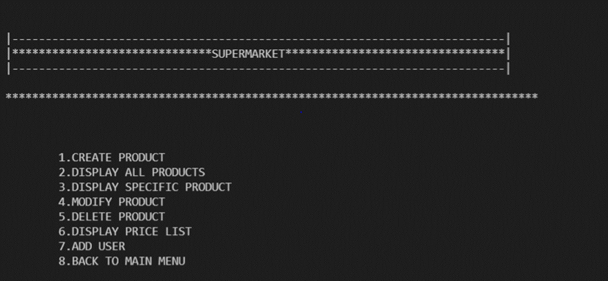
Output summary Main menu

Slide 10
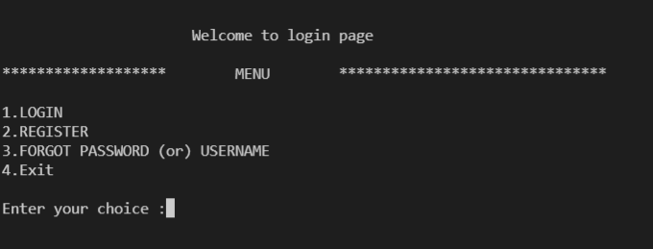
Login page

Slide 11
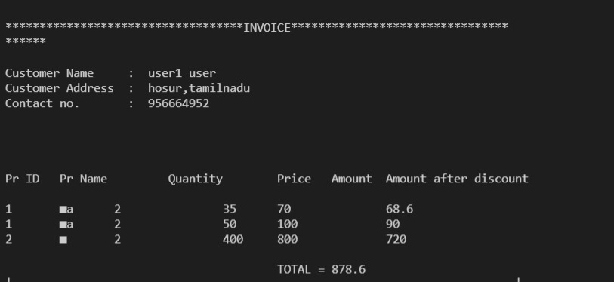
Final output

Slide 12
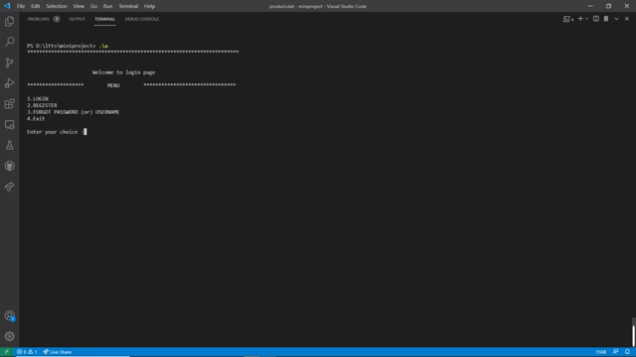
Working video

Slide 13
Summary
After combining everyone’s work we are able to develop supermarket management system. This helps shopkeeper to keep track of products, organize efficiently and supervise effectively. Hence he/she can give better service to the customer. It provides multiple options to the shopkeeper such as add new product, view all products or specific product, modify any product, delete any product. Based on these details customer/shopkeeper can find product details accurately.
Challenges faced
Had problem in saving the information in .dat and .txt file format. Used reinterpret_cast to solve the issue.
Dealing with the billing for each user. Used inheritance from both product and user to resolve.

Slide 14


Thank You !

